Slide 1
Journal Club
Preservation methods differ in fecal microbiome stability, affecting suitability for field studies
August 11th, 2016
Marc Sze

Slide 2

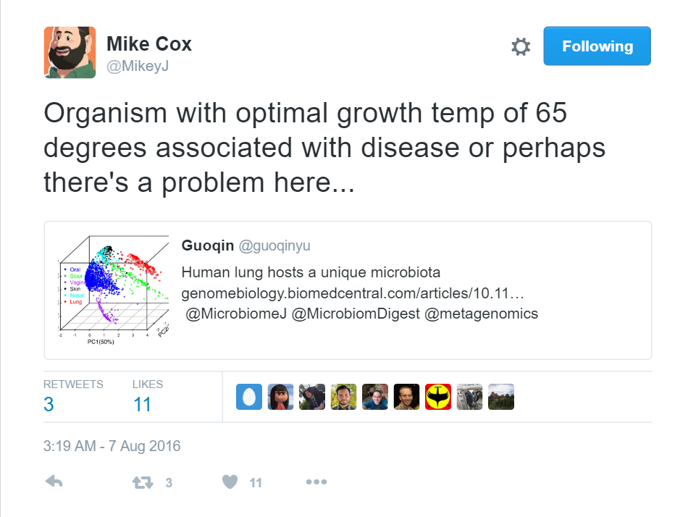
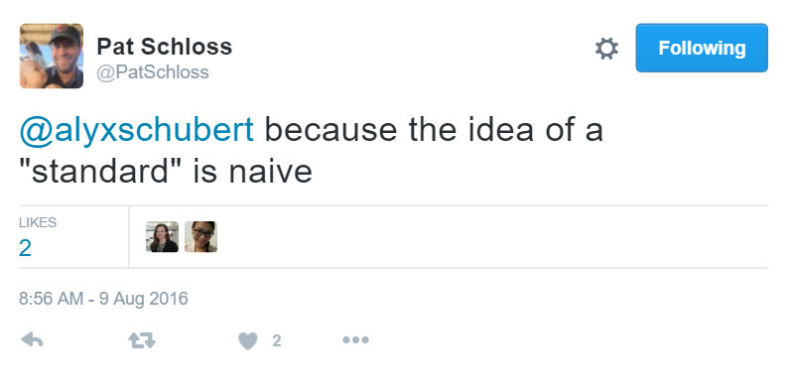
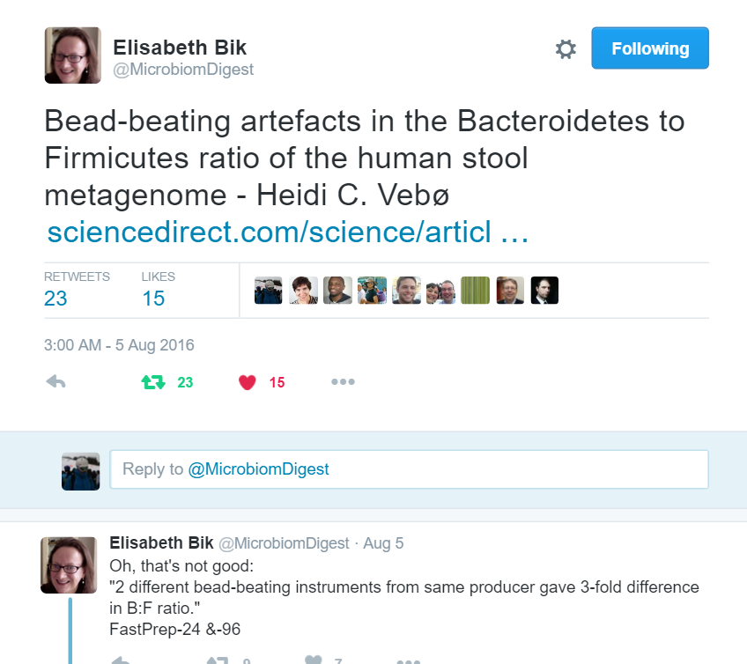
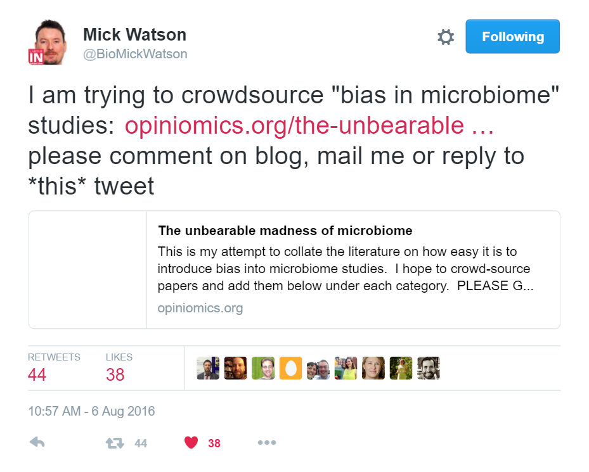
Introduction
Notes:
Mention that for discovery I agree that a standardized approach may be counter-productive.
However, as treatments move towards more repeatability and closer to actual patients a standardized approach is needed for important cross study comparisons.

Slide 3
Introduction
So why not forget about it and let everyone do their own thing?
Weakens a powerful tool we have in pooling data
May be problematic to correct for these differences using bioinformatics
Can introduce bias in results
May make reproducibility difficult
E.g. a specific Taq or storage reagent is discontinued

Slide 4
Introduction
Reduction or
increase by a fixed amount
Actual Values
Set threshold
or amount
sampled
Combination or
Random bias/changes
Notes:
Reduction or increase can probably be accounted for in mixed effect models and the framework of a meta-analysis
However, the other two would probably be easier to address at the molecular biology level rather than the informatics level
Current study tries to address issues that are part of the first group and potentially how much could be explained by things in the third grouping.

Slide 5
Study Overview
Sample Breakdown
360 samples from 4 time points
15 x 6 preservation methods (90)
90 x 4 time points
540 samples from 4°C and -20°C
90 x 2 storage temperatures (180)
180 x 3 time points
180 samples from RT to -20°C
90 x 2 (3wks or 7wks)
150 sample from mimics
75 change temp wait 1 week
75 change temp wait 8 weeks
No Whatman FTA cards used
1230 total + 109 extraction blanks + 15 FTA controls + 180 technical replicates = 1534
Total kept 1127 ~ 73.4%
171/180 technical replicates kept (~95%)
Notes:
I like the study design, don’t like the way they made it difficult to get the breakdown of samples per group

Slide 6
Some Caveats from Data generation
Used Earth Microbiome Project Protocol
PowerSoil with 20 mins @ setting of 20
Pooled 3 PCR reaction together per sample
Sequencing using HiSeq (125nt read length used)
Unique barcode only in Forward direction
Samples failed on HiSeq were re-sequenced on MiSeq
OTU generation used an Open Reference approach
Diversity Measures
Unweighted UniFrac
Weighted UniFrac
Switched to Bray-Curtis for detrending
Notes:
Extraction: Problem with DNA shearing with kits like OmniGeneGut
Sequencing:
1) Using very short reads for the V4 (could overestimate similarity)
2) Single index, single end sequencing leads to high error rate (Kozich, et al.)
OTU generation: open reference could over-estimate similarity
Diversity:
UniFrac probably overestimates similarity (mostly due to simpler presence/absence based approach)
Weighted UniFrac dependent on sequence depth and rare OTUs could cause problems.

Slide 7
Results: Weighted and unweighted UniFrac
Unweighted
Weighted
Fresh Samples are the
larger circles.

Slide 8
Results: Sample Variability

Slide 9
Results: Sample Variability Cont.
Notes:
Wait to see if anyone finds the problem with this graph versus the previous one.

Slide 10
Results: Classification Accuracy
Train on 0 hours test on other timepoints
random forest and caret (http://topepo.github.io/caret/index.html)
Predict individual regardless of treatment
Notes:
Caret – Classification and regression training
Uses a Bagged Model (caret) to tune data – a sort of bootstrap aggregation
Bootstrap aggregation – divides data into smaller parts, with replacement, which have similar variation and distribution. Taking the average of all the fits gives the fit that is used for any future classifications.

Slide 11
Results: Temperature Treatments
Notes:
Showing at various time points.

Slide 12
Results: Bias
Giavarina, D. Understanding Bland Altman analysis. Biochemia Medica. 2015
Notes:
Question – Would you say that there is low bias between the two methods? (yes, no, not enough info)
Note here that to really look at Bias need to use a Bland-Altman plot and analysis
Describe a Bland-Altman plot: Similar to what is called a Tukey mean-difference plot (if you know what that is).
From Wikipedia: Bland and Altman make the point that any two methods that are designed to measure the same parameter (or property) should have good correlation when a set of samples are chosen such that the property to be determined varies considerable. A high correlation for any two methods designed to measure the same property could thus in itself just be a sign that one has chosen a widespread sample. A high correlation does not necessarily imply that there is good agreement between the two methods.
Case A: Random Variability
Case B: Constant Variability

Slide 13
Results: Bias

Slide 14
Results: Detrending
Not sure if this graph really represents what authors wanted it to.
Shows FTA cards might be influencing Bray-Curtis distances.
Shows others do not have such a relationship.
Notes:
Definition taken from http://www.ltrr.arizona.edu/~dmeko/notes_7.pdf
Detrending is the statistical or mathematical operation of removing trend from the series. Detrending is often applied to remove a feature thought to distort or obscure the relationship of interest. Alternatively detrending is also sometimes used as a preprocessing step to prepare time series for analysis by methods that assume stationarity.
**Need to point out that detrending, if there is distortion will improve results.
- Limitations
- Same formula may not be ideal for every group
- if it doesn’t work hints at no distortion in time-series data due to measure (e.g. time, media, etc.)

Slide 15
Thank you for your time and attention!!!

